Slide 1

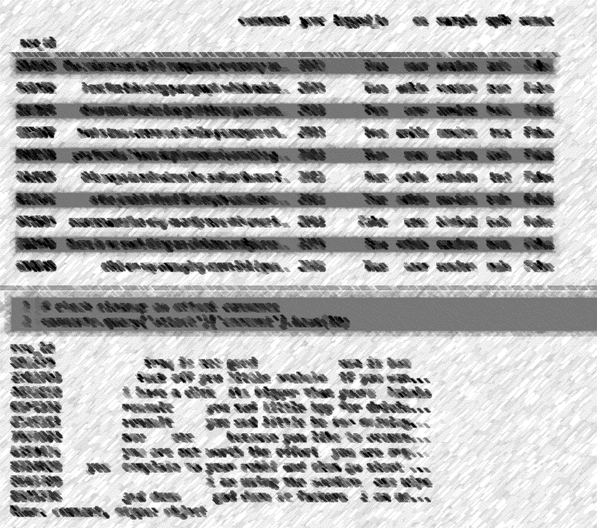

An ML approach to filtering distasteful Wiki comments
Joffrey Inocencio, Align
Northeastern University - Seattle
CS5100 – AI Foundations
Dec 3, 2020

Slide 2

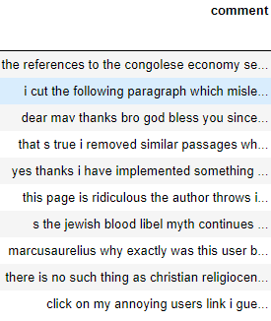
Text Cleanup
Make text all lower case
Remove punctuation
Remove numerical values
Remove stop words (via TfidfVectorizer)
Optimizations
Pre-processed Text
Processed Text
lambda x:
x.lower()
re.sub(string.punctuation)
'\w*\d\w*'
Notes:
a. What text cleaning methods did you try? Which are the ones you included in the final code?
Diving right into our text data, we see that on the left side comment box that there needs to be quite a bit more cleanup. First, I wanted to make all of the text to be lower case which was applied by the method lower(). There was also various punctuation marks in our unfiltered pre-processed text and so that needed to be removed, or rather, replaced with a space key. I don’t really believe numbers add any significance or sentiments to the comments so that was removed using a regex expression, also replaced with a space key. Applying these cleanup strategies, I was able to successfully process the text data into a much cleaner dataset.
I didn’t notice a drastic difference in our precison, recall or f1 scores using the above cleanup. But rather, I saw noticeable difference only after applying stop words which increased my f1 scores by 3% on the strawman model

Slide 3
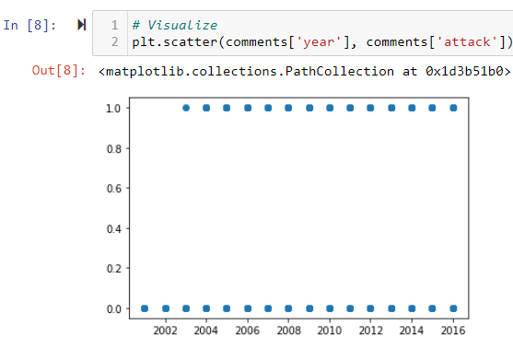
Feature Extraction
Optimizations
F1-Scores Attack mean() | Mean > 0.4 | Mean > 0.5 | Mean > 0.6 | Mean > 0.7
FALSE | 0.96 | 0.97 | 0.97 | 0.98
TRUE | 0.68 | 0.68 | 0.67 | 0.66
analyzer (words vs chars)
FALSE = classify positive comments
True = classify negative comments
F1-Scores char | Both
FALSE | 0.93
TRUE | 0.48
F1-Scores words | Unigrams | Bigrams | Both
FALSE | 0.97 | 0.94 | 0.97
TRUE | 0.68 | 0.23 | 0.68
stop_words only effective if analyzer == word
Notes:
b. What are the features you considered using? Which features did you use in the final code?
As far as features, I tried using unigrams, bigrams, and both unigrams and bigrams. I found most success when analyzing for words, and less so with chars. I initially wanted to replicate or follow the description outlined by the authors of the dataset in their Ex Machina paper,. but I ran into low memory errors. I suppose this can be expected considering the magnitude of n-grams analyzed for 1-5 chars across a large, 40 something megabyte file. So that didn’t work as planned. Rather, I stuck with the provided strawman method in analyzing for words, which gave nice results to begin with. Of course, my results were improved upon later, especially after applying a stronger machine learning method .
c. How did you decide to use the ‘attack’ information from different annotators?
d. What optimizations did you add in your code, if any?
-For optimizations and how I used the “attack” information, I found that manipulating the labels mean() away from the majority affected the f1 scores such that further deviation away where attackers mean() is greater than 0.5 resulted in decreasing the f1-score for classifying nasty comments. Conversely, increasing this threshold improved f1-score for correctly classifying nice comments and ultimately improved the weighted average f1 score. But even considering this, I felt it was more appropriate to maximize the correct classification for nasty comments, as I thought that classifying negative comments was more of the general purpose for this classifier. In turn, this optimization also led to the removal of comments before 2003, since there were no recorded attacks; this was marginal as that it seems approximately 8 comments were removed

Slide 4
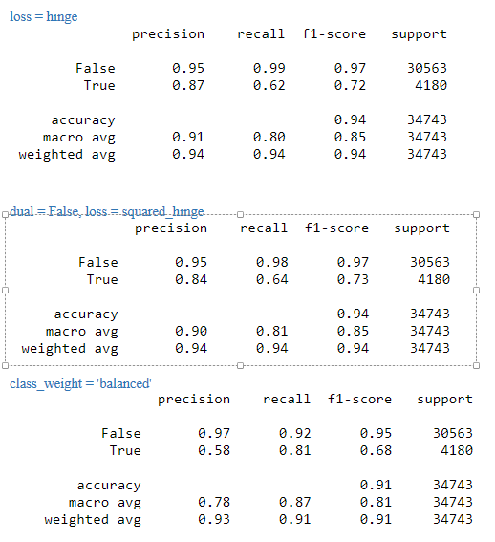
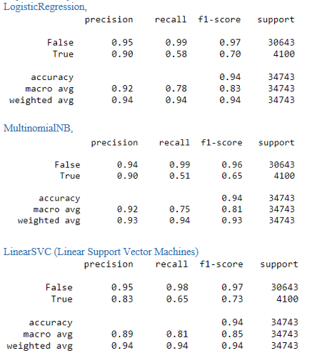



LinearSVC(penalty='l2', loss='squared_hinge', dual=False,tol=0.0001, C=1.0,multi_class='ovr', fit_intercept=True,intercept_scaling=1 class_weight=None, verbose=0, random_state=5, max_iter=10000))
Modeling the data
train_test_split(
data = comments,
test_size = 0.3,
train_size = 0.7)
Logistic Regression(Second Best)
Multinomial Naive Bayes
Linear Support Vector Classifier (Best)
classifier)
Final Results/Report ->
Notes:
e. What are the ML methods you tried out, and what were your best results with each method? Which was the best ML method you saw before tuning hyperparameters?
As for the Machine learning methods I tried out, I used:
- MultinomialNB (Naieve Bayes)
- LogisticRegression (Second best, worked really well when trying to improve strawman method with better metrics)
- However, I found LinearSVC to be give the Best results even at default parameters.
I did try tuning hyperparameters for the LinearSVC, but I did not receive significantly improved results.
f. What hyper-parameter tuning did you do, and by how many percentage points did your accuracy go up because of hyper-parameter tuning?
- Rather, I got only a slight increase of 1% is seen in our True precision, but this could be from a randomized state computation of our data. Accuracy did not change from 0.94 overall.
g. What did you learn from the different metrics? Did you try cross-validation?
- From the metrics, it seems that the data strongly supports classifying nice comments. This makes sense since supporting comments(30k) are about 7x more evident than nasty comments(4k) in our processed and pipelined dataset. I was unable to try cross-validation, but I did try to implement a train_test_split using test = 0.3 and complimentary train = 0.7. The accuracy started at 0.91 with the strawman, and I was able to raise the accuracy up to 0.94
h. What are your best final Result Metrics? What is the increase in accuracy compared to the strawman figure? Which model gave you this performance?
- My best final result metric was getting the True f1-score above 0.7 which started from the strawman True f1-score of 0.63 which was acchieved using the LinearSVC method with default parameters.

Slide 5
End
Notes:
e. What are the ML methods you tried out, and what were your best results with each method? Which was the best ML method you saw before tuning hyperparameters?
As for the Machine learning methods I tried out, I used:
- MultinomialNB (Naieve Bayes)
- LogisticRegression (Second best, worked really well when trying to improve strawman method with better metrics)
- However, I found LinearSVC to be give the Best results even at default parameters.
I did try tuning hyperparameters for the LinearSVC, but I did not receive significantly improved results.
f. What hyper-parameter tuning did you do, and by how many percentage points did your accuracy go up because of hyper-parameter tuning?
- Rather, I got only a slight increase of 1% is seen in our True precision, but this could be from a randomized state computation of our data. Accuracy did not change from 0.94 overall.
g. What did you learn from the different metrics? Did you try cross-validation?
- From the metrics, it seems that the data strongly supports classifying nice comments. This makes sense since supporting comments(30k) are about 7x more evident than nasty comments(4k) in our processed and pipelined dataset. I was unable to try cross-validation, but I did try to implement a train_test_split using test = 0.3 and complimentary train = 0.7. The accuracy started at 0.91 with the strawman, and I was able to raise the accuracy up to 0.94
h. What are your best final Result Metrics? What is the increase in accuracy compared to the strawman figure? Which model gave you this performance?
- My best final result metric was getting the True f1-score above 0.7 which started from the strawman True f1-score of 0.63 which was acchieved using the LinearSVC method with default parameters.

